Slide 1
Big Data Technology
Quoc huy luong -987042

Slide 2
Project Part 1
We will need to put those Twitter credentials into twitter.txt file with the content below
We will use Spark Streaming to get the popular hashtags from Twitter
We will need to register a developer account with Twitter to able to access their data at https://developer.twitter.com

Slide 3
Project Part 1
First, we will create a StreamingContext and a DStream from Twitter
We will use Spark Streaming to get the popular hashtags from Twitter
This part using Scala, SBT and IntelliJ.

Slide 4
Project Part 1
Then, we will transform the DStream from Twitter and filter out hashtags.
We will use Spark Streaming to get the popular hashtags from Twitter

Slide 5
Project Part 1
Then, we will count these hashtags in a 5 minutes window and sort the result by number of counts descending. Finally, we will print out the top 10 popular ones.
We will use Spark Streaming to get the popular hashtags from Twitter

Slide 6
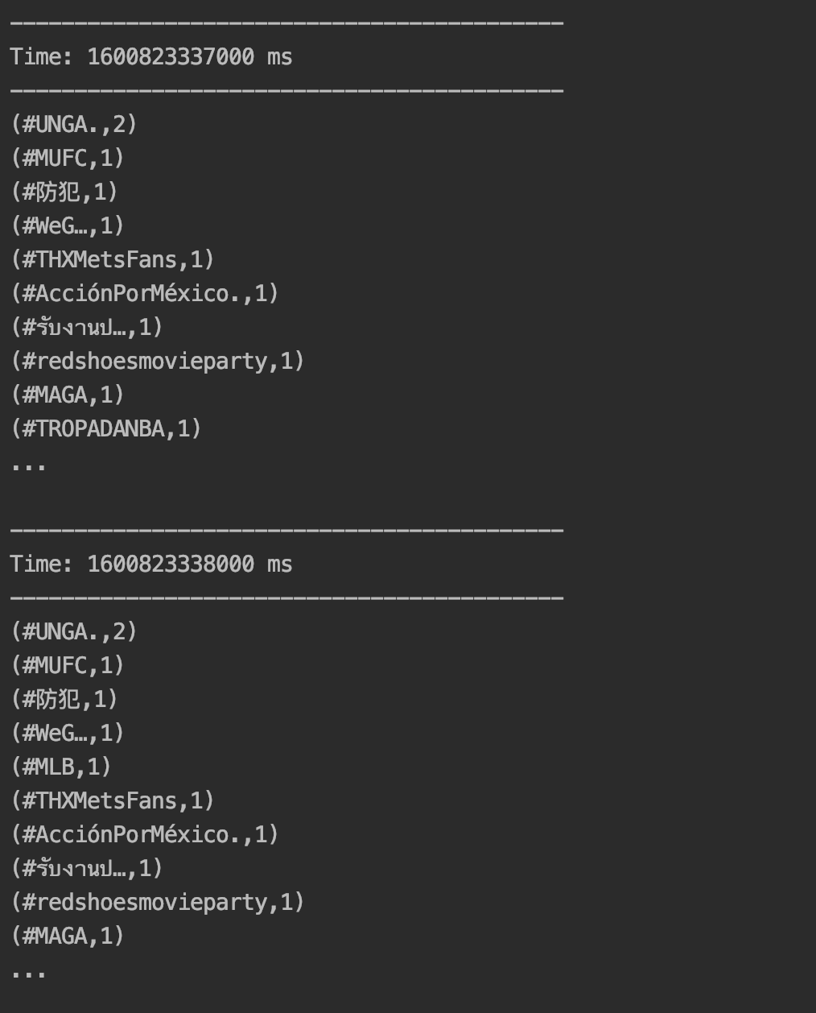
Project Part 1
Here is a screenshot of the result

Slide 7
Project Part 2
We will add some codes into Part 1 to save all data into HDFS that can be used by Hive to query data.
Integrate with Hive

Slide 8
Project Part 2
We will create a table in Hive to load all data we streamed.
Integrate with Hive

Slide 9
Project Part 2
Then we can write a query to retrieve the data.
Integrate with Hive

Slide 10
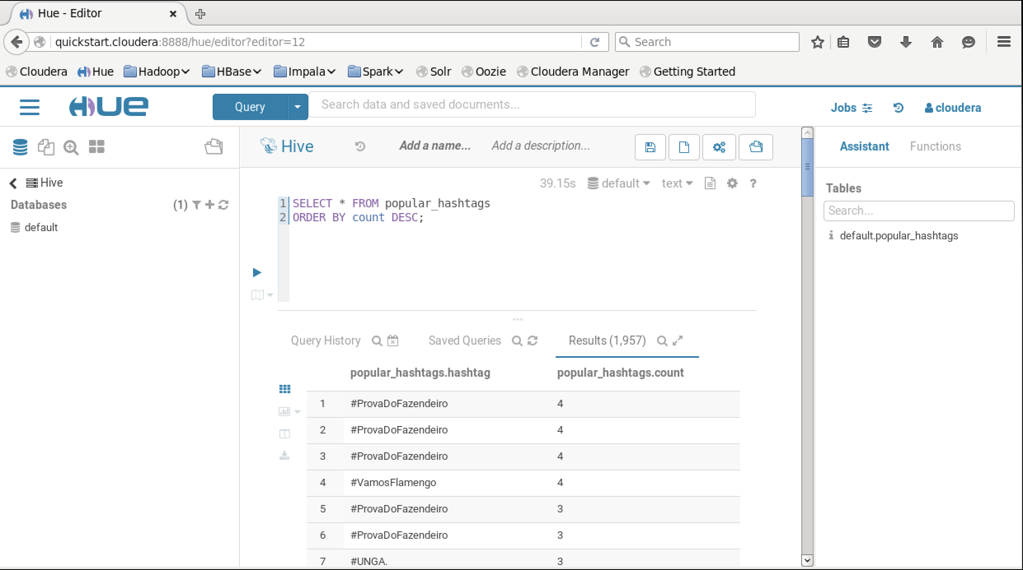
Project Part 2
Here is the result from Hive on Hue.
Integrate with Hive

Slide 11
Project Part 3
We need to setup Kafka on a local machine.
Kafka setup instructions for Windows: https://dzone.com/articles/running-apache-kafka-on-windows-os
Kafka setup instructions for MacOS: https://medium.com/@Ankitthakur/apache-kafka-installation-on-mac-using-homebrew-a367cdefd273
Kafka Example
Read a web access log file from Kafka

Slide 12
Project Part 3
Now start Zookeeper and Kafka:
Kafka Example
Read a web access log file from Kafka

Slide 13
Project Part 3
Create Kafka Topic for our example:
Kafka Example
Read a web access log file from Kafka

Slide 14
Project Part 3
Run our example app and then run Kafka producer to produce data:
Kafka Example
Read a web access log file from Kafka

Slide 15
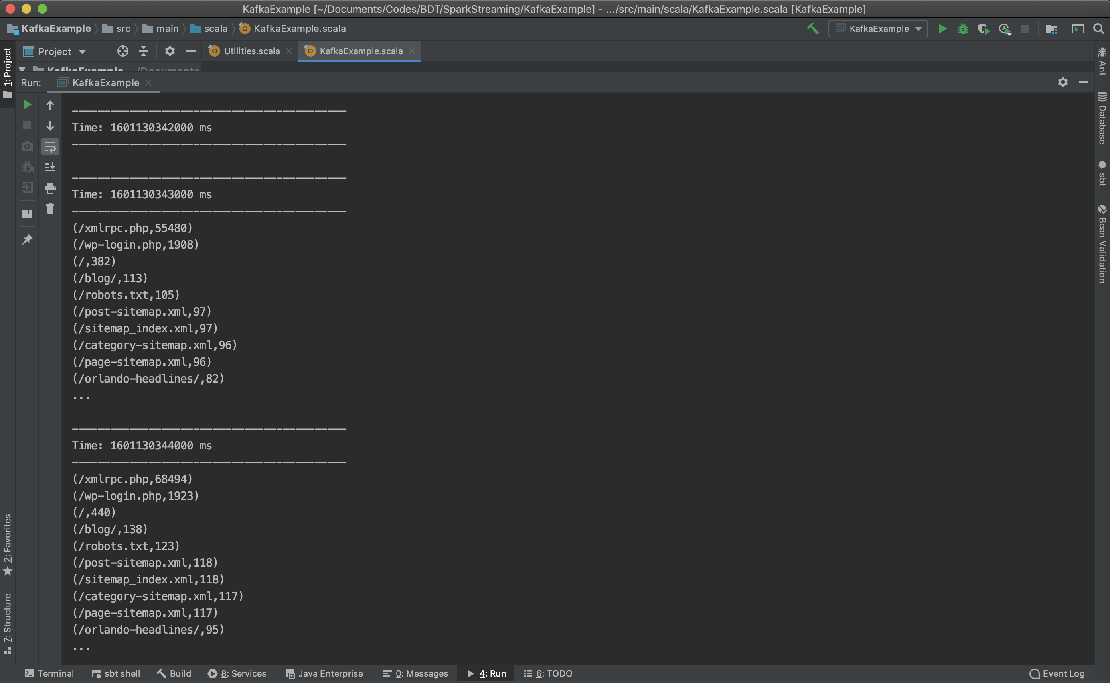
Project Part 3
Here is the result from our app:
Kafka Example
Read a web access log file from Kafka

